Slide 1

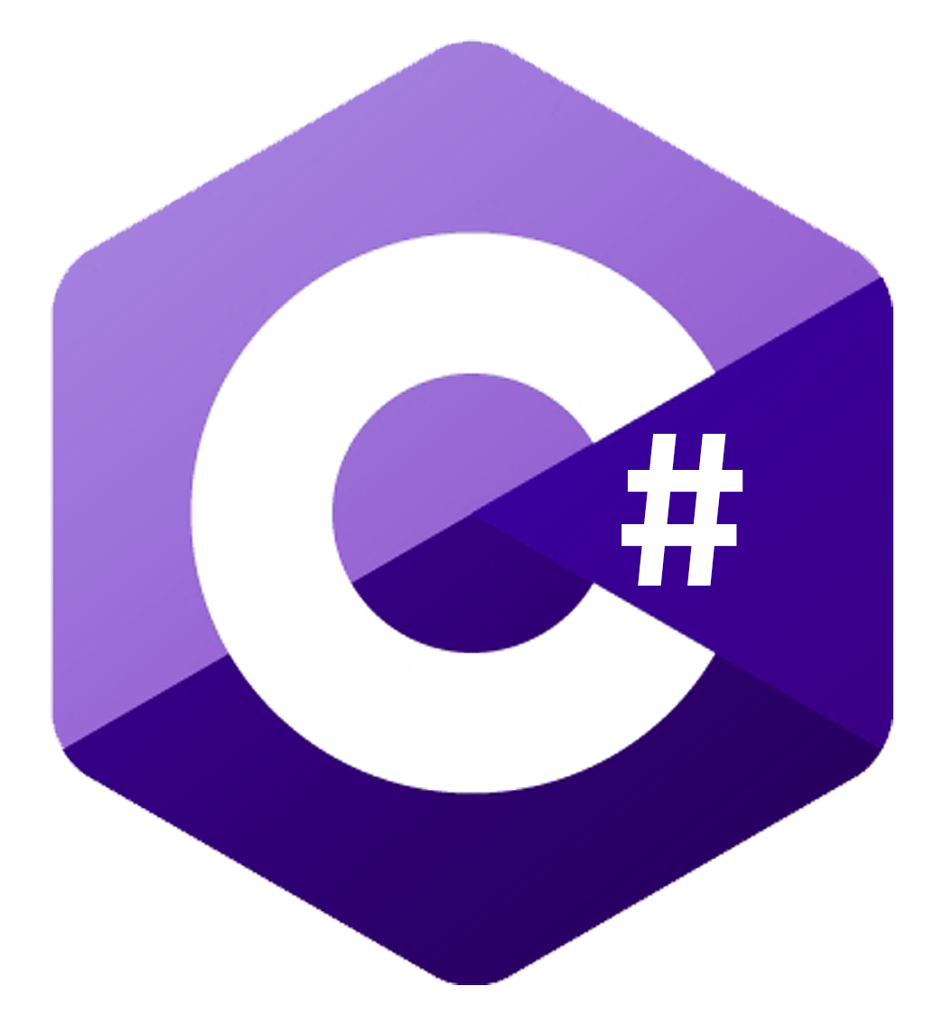
Shoals O’ Plenty
Game Programming Capstone Project
By Ben Perryman
Notes:
Resources:
C# logo: https://github.com/exercism/meta/issues/27
Unity Logo: https://www.google.com/url?sa=i&url=https%3A%2F%2Finvestors.unity.com%2Foverview%2Fdefault.aspx&psig=AOvVaw2tax67JVP1hWcZ808Nbd1v&ust=1700999584651000&source=images&cd=vfe&opi=89978449&ved=0CBQQjhxqFwoTCLi9zbGL34IDFQAAAAAdAAAAABAE

Slide 2
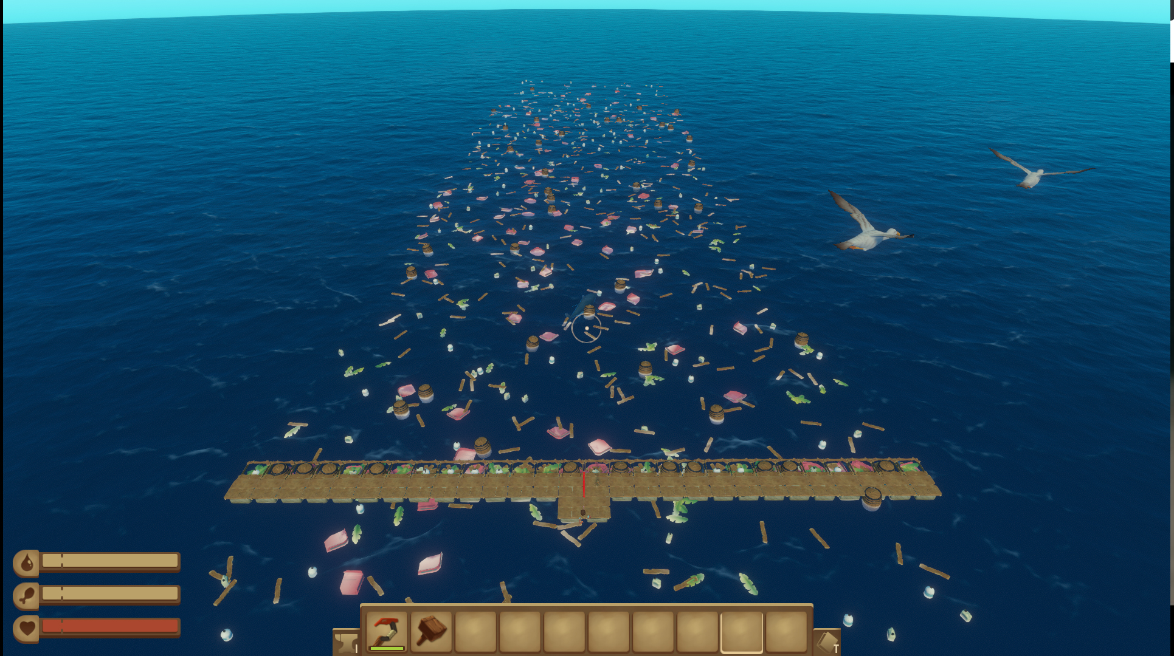
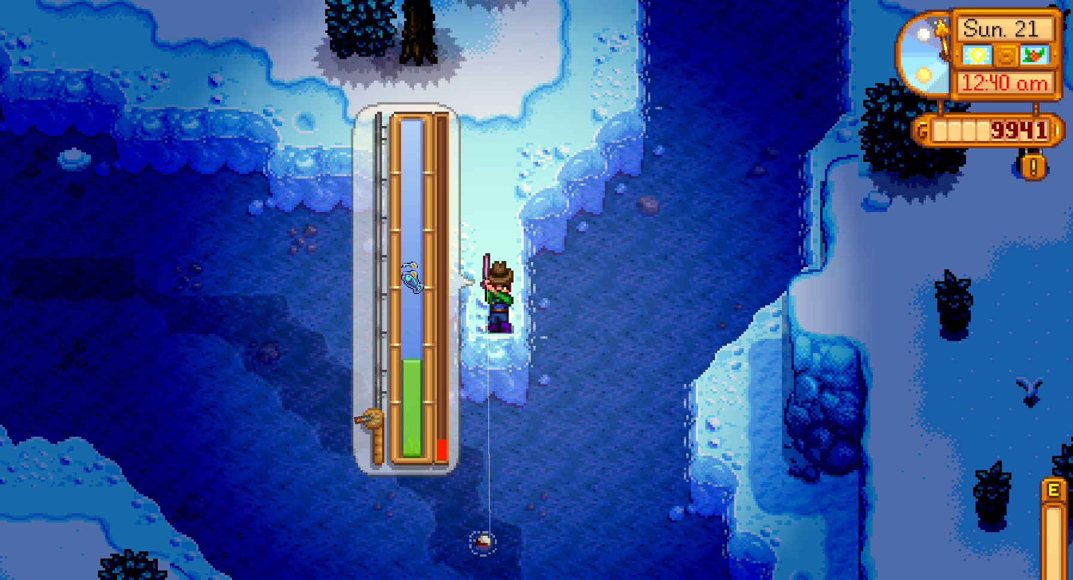
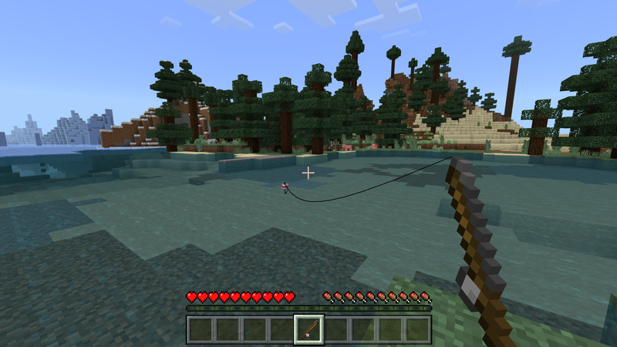
Project Scope:
Island Survival Based Game
Gameplay centering around:
Constant need to eat, drink, and sleep
Getting resources to survive.
Repairing a boat with resources to win.
In-game Resources come from fishing.
Examples/inspirations:
Minecraft. Mojang Studios, 2009.
Stardew Valley. ConcernedApe, 2016.
Raft. Redbeet Interactive, 2022.
Notes:
Resources:
Minecraft Image: https://minecraft.wiki/w/Fishing#/media/File:Fishing.png
Stardew Valley Image: https://stardewcommunitywiki.com/File:Glacierfish_after_12am.png
Raft Image: https://raft.fandom.com/wiki/Game_Mechanics

Slide 3
Initial Project Goals:
Create a small game with complex features.
1
Further my knowledge and experience with C# programming and the Unity Engine.
2
Learn firsthand how challenging developing a functional game is from your own concepts.
3
Notes:
Resources:
Unity Logo: https://www.google.com/url?sa=i&url=https%3A%2F%2Finvestors.unity.com%2Foverview%2Fdefault.aspx&psig=AOvVaw2tax67JVP1hWcZ808Nbd1v&ust=1700999584651000&source=images&cd=vfe&opi=89978449&ved=0CBQQjhxqFwoTCLi9zbGL34IDFQAAAAAdAAAAABAE

Slide 4
Continuing with Unity:
Knowledge Level: Slightly Above Basic Experience
Previously took the Game Programming NSU course
Working with Unity provides:
Wonderfully versatile game engine for all types of projects.
Customizability with Unity’s package system and Asset Store.
Helpful user forums to further understand issues.
Online documentation for engine functionalities.
Notes:
Resources:
Unity Logo: https://www.google.com/url?sa=i&url=https%3A%2F%2Finvestors.unity.com%2Foverview%2Fdefault.aspx&psig=AOvVaw2tax67JVP1hWcZ808Nbd1v&ust=1700999584651000&source=images&cd=vfe&opi=89978449&ved=0CBQQjhxqFwoTCLi9zbGL34IDFQAAAAAdAAAAABAE

Slide 5
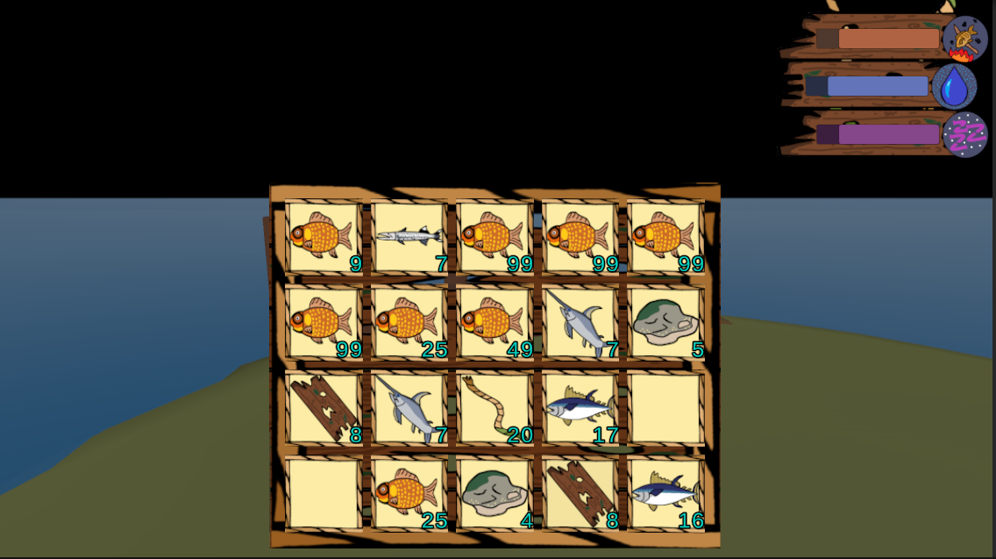
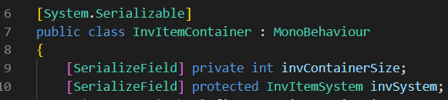
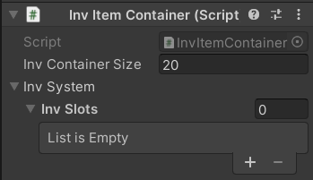
Inventory System
Lots of different tutorials online, Dan Pos on YouTube was a great help.
Scriptable Objects hold item data.
List entries hold item data containers.
Serialization helps keep track of hidden data.

Slide 6
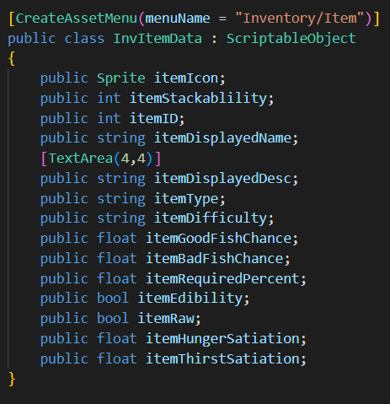
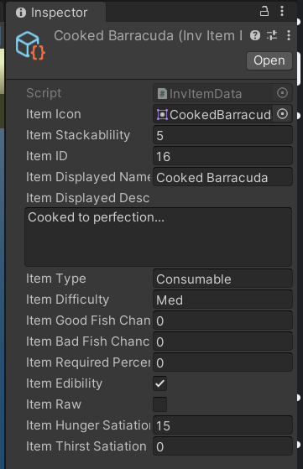
Scriptable Objects

Slide 7
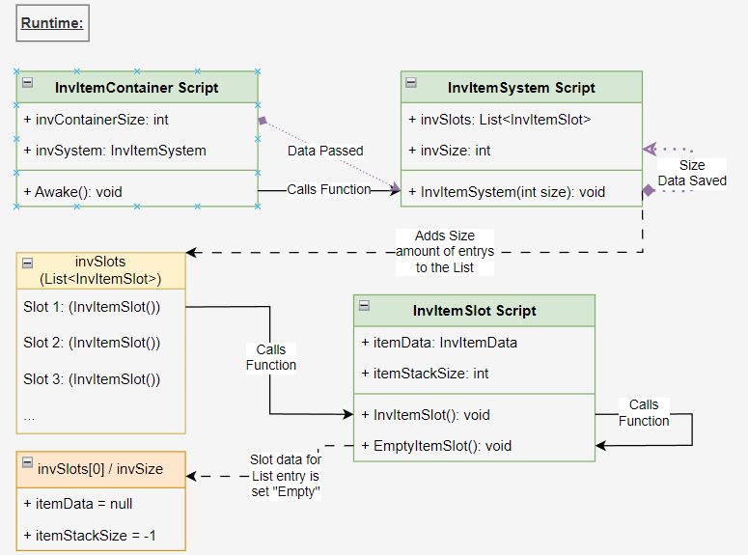
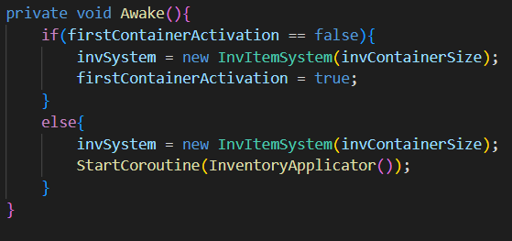
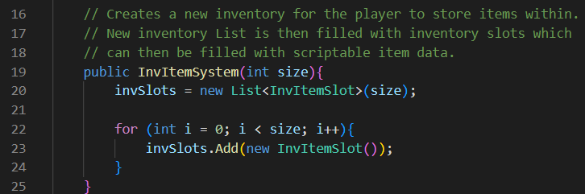
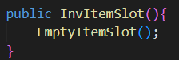
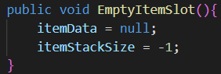
Notes:
Made using: Draw.io https://app.diagrams.net/

Slide 8
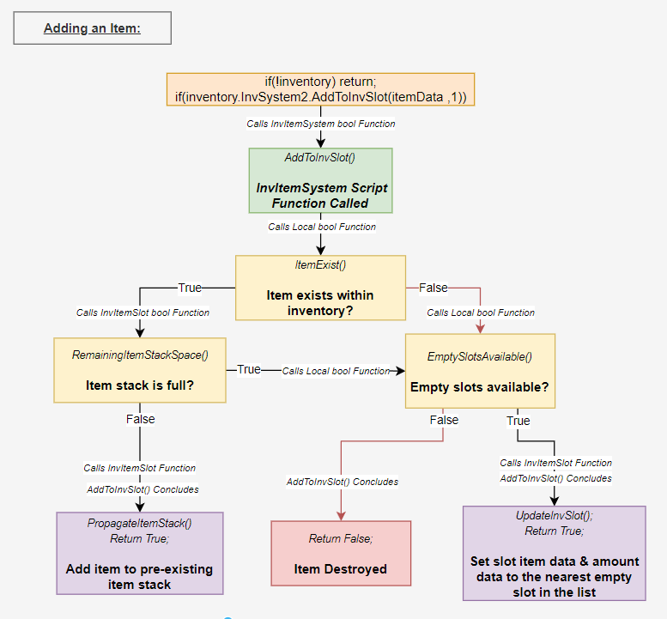
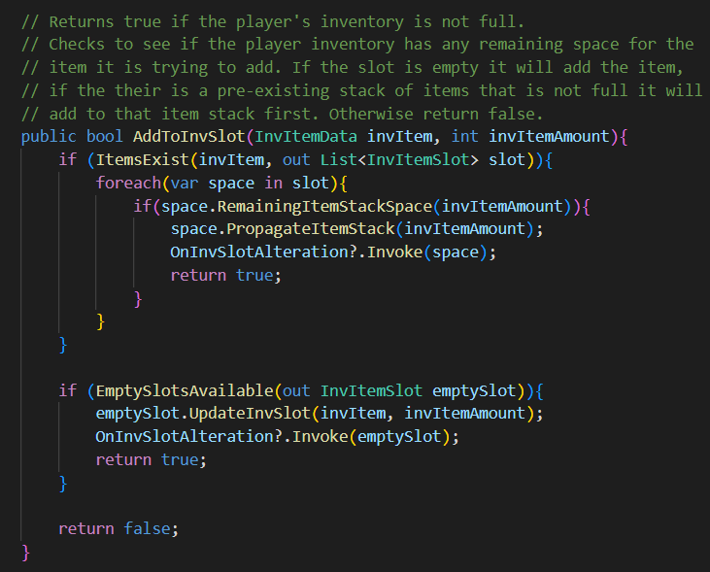
Notes:
Made using: Draw.io https://app.diagrams.net/

Slide 9

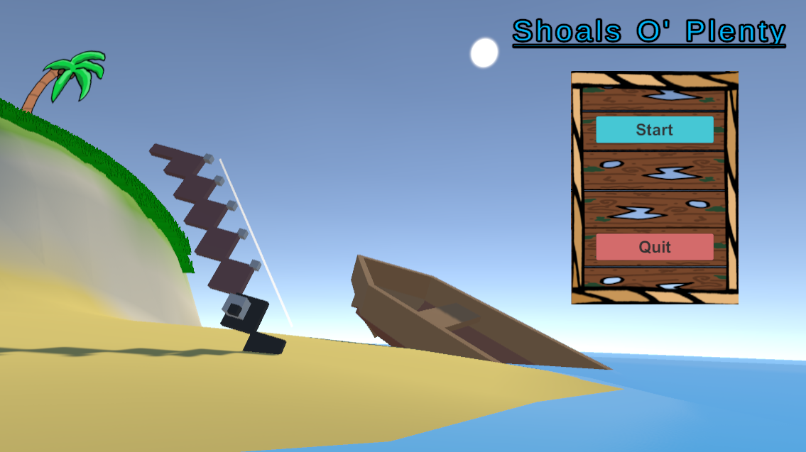
Demo Time

Slide 10
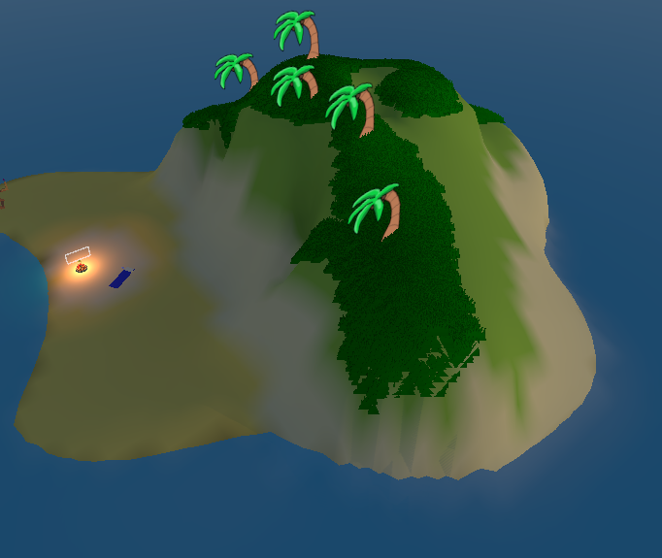
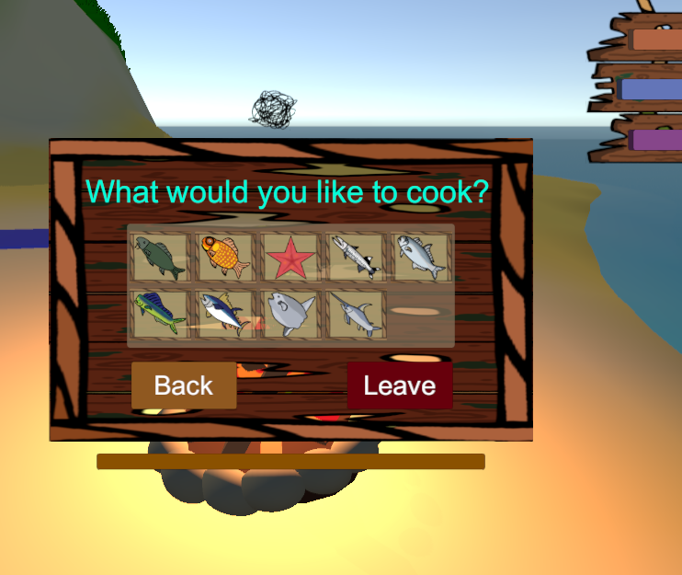
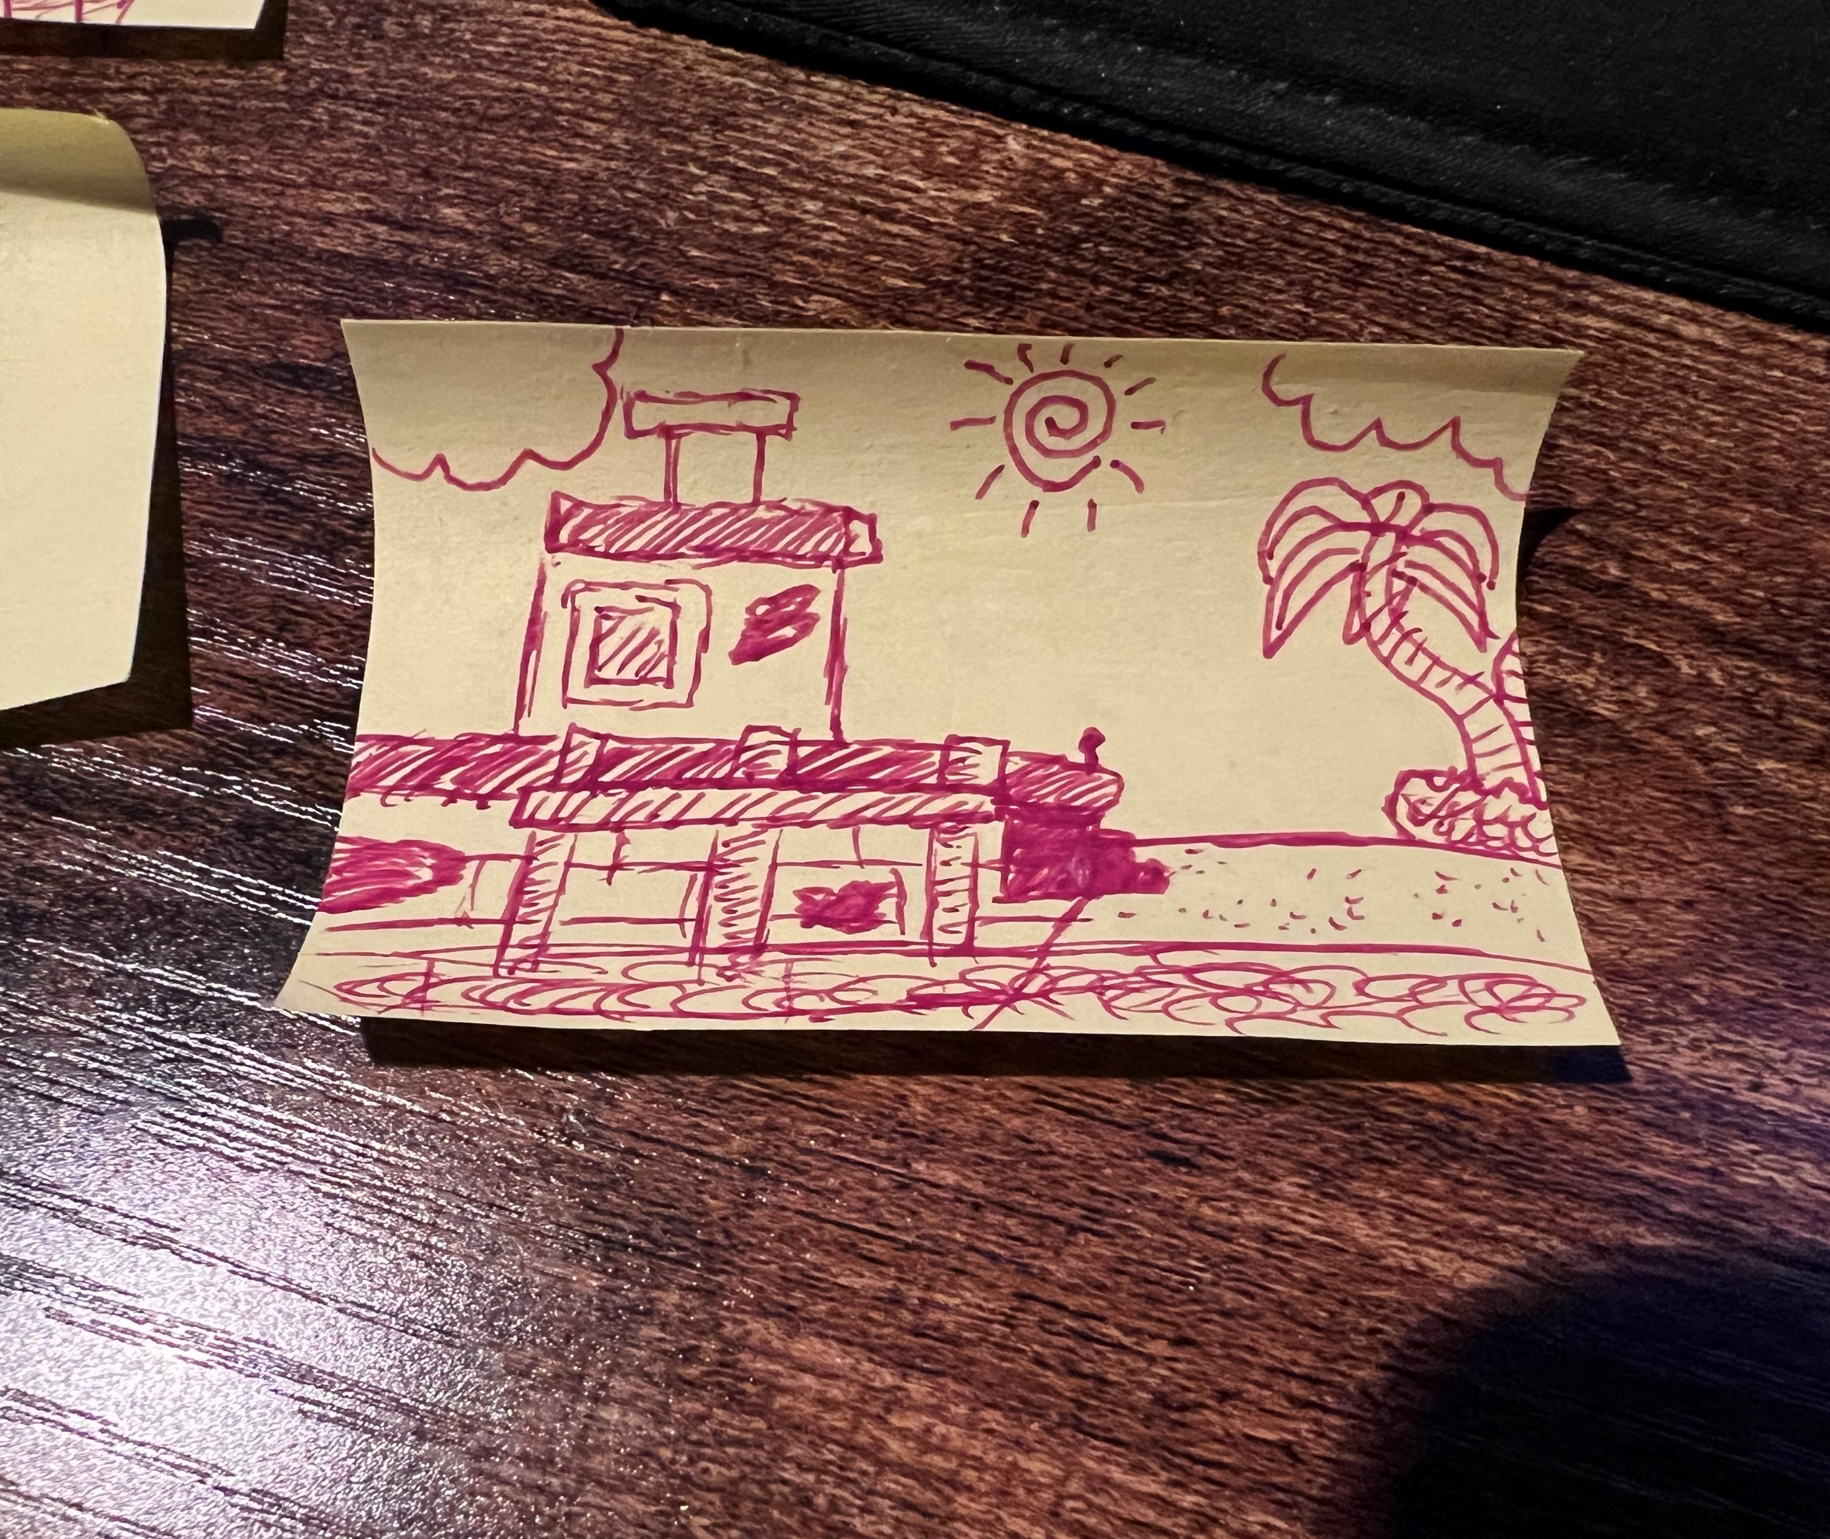
Island/Stations Creation
First section worked on
Unity Terrain Tool experience
Player and camera movement
Developing menus

Slide 11
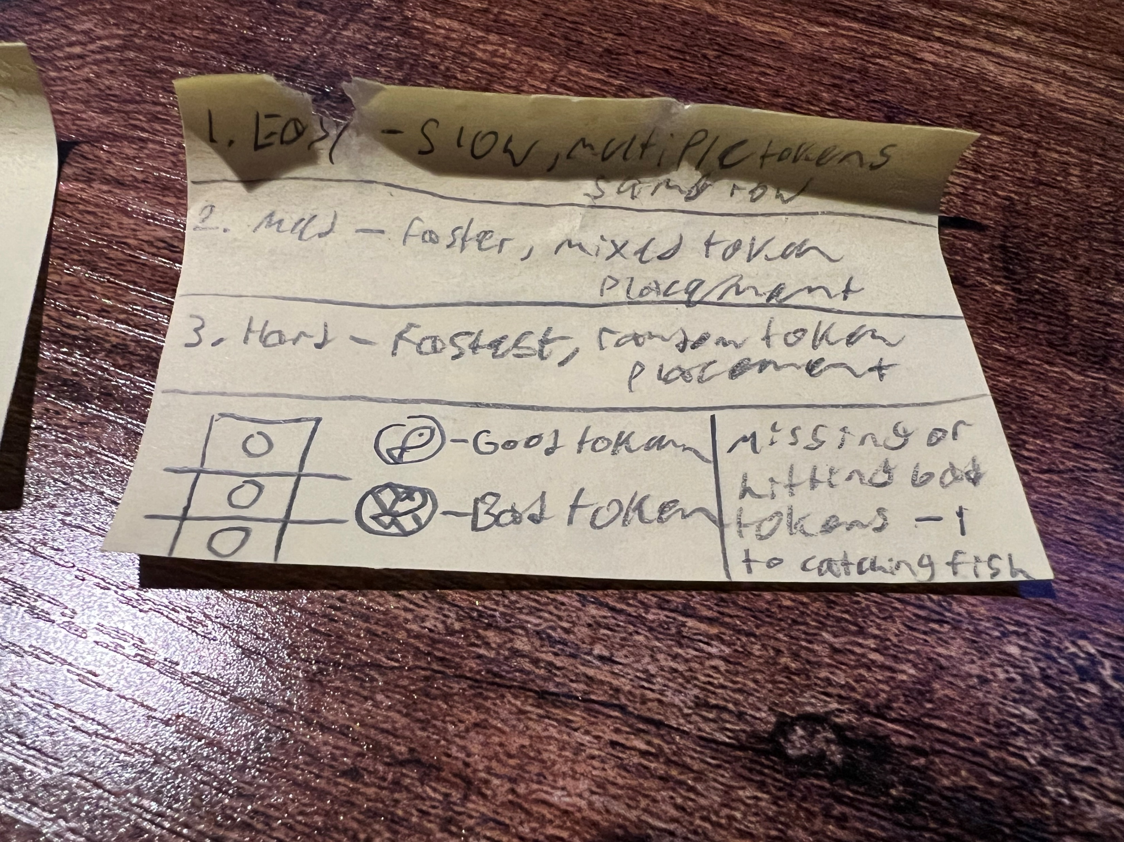
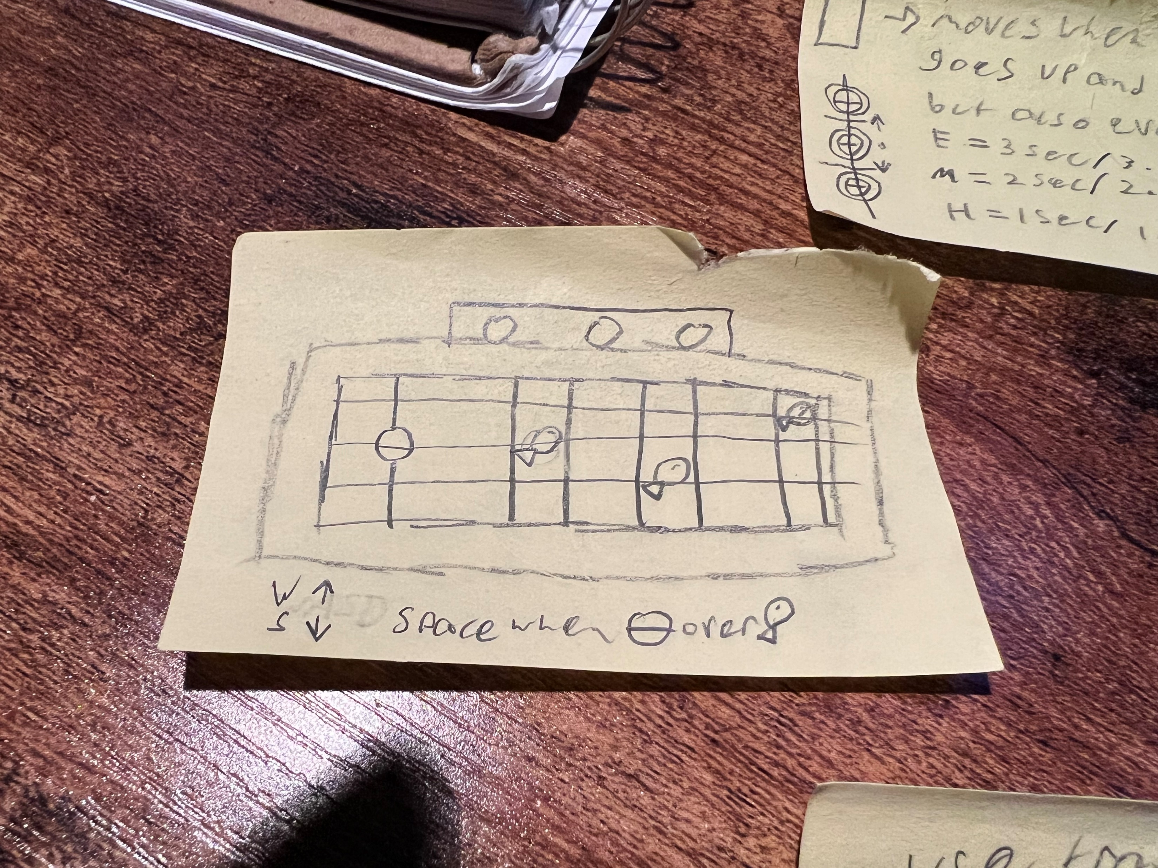
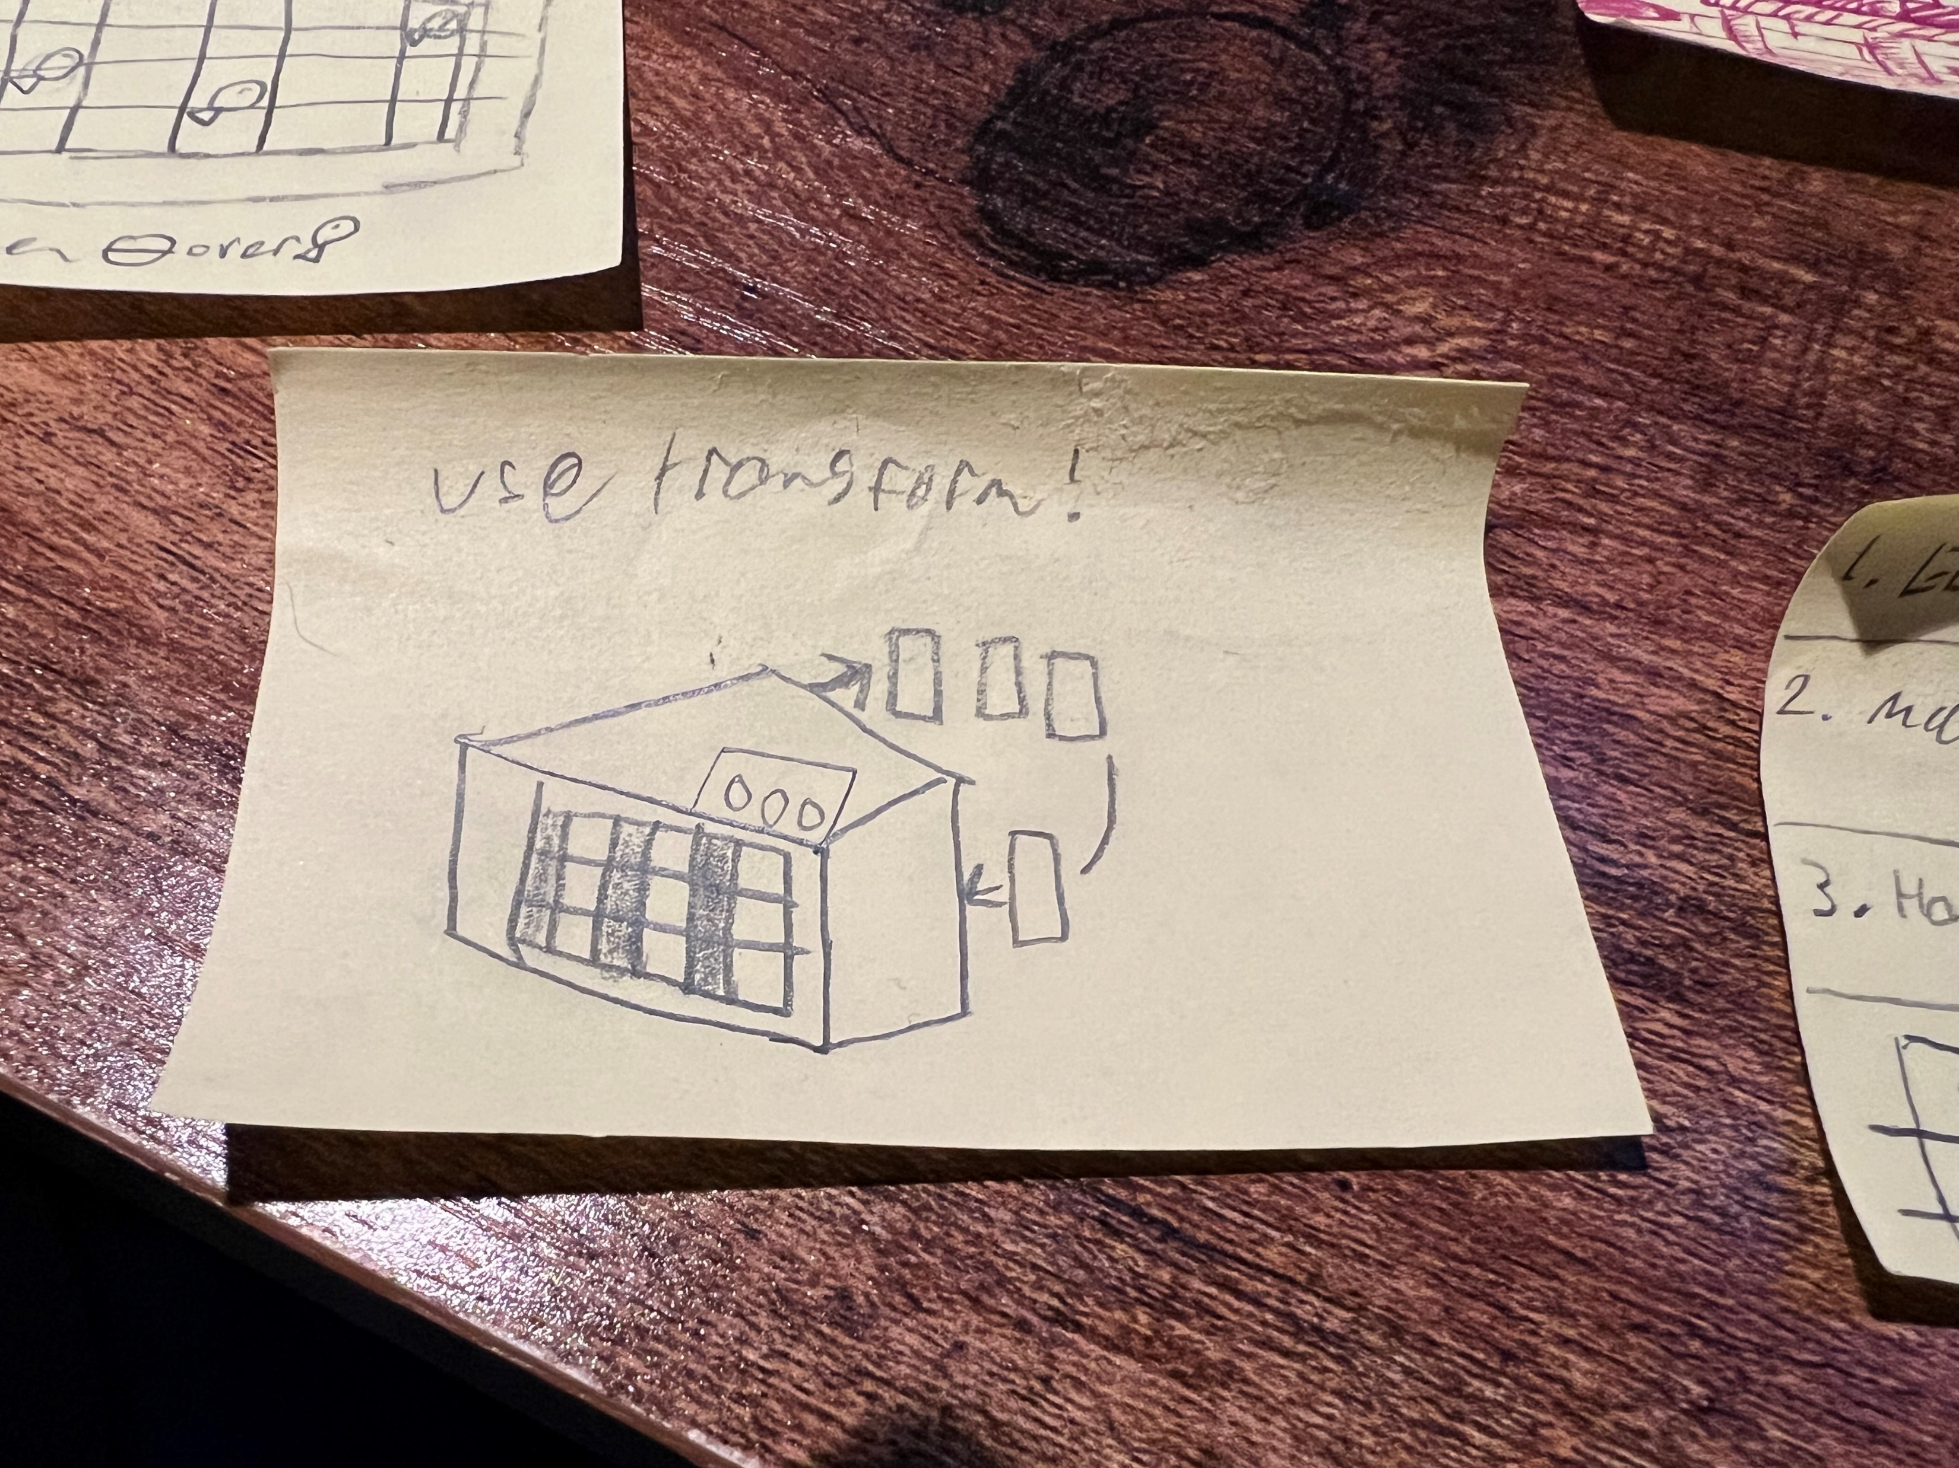
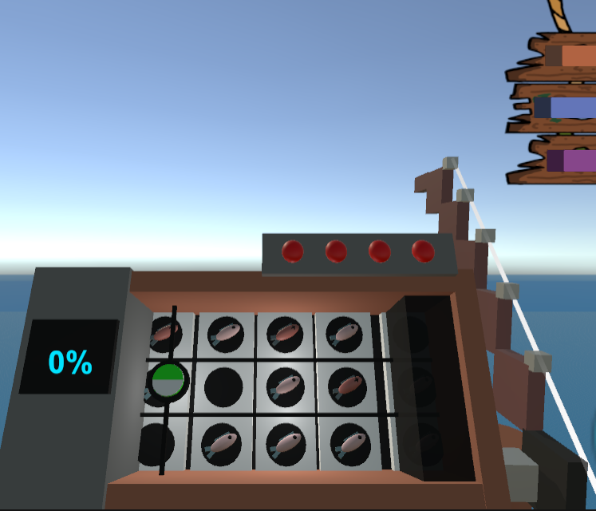
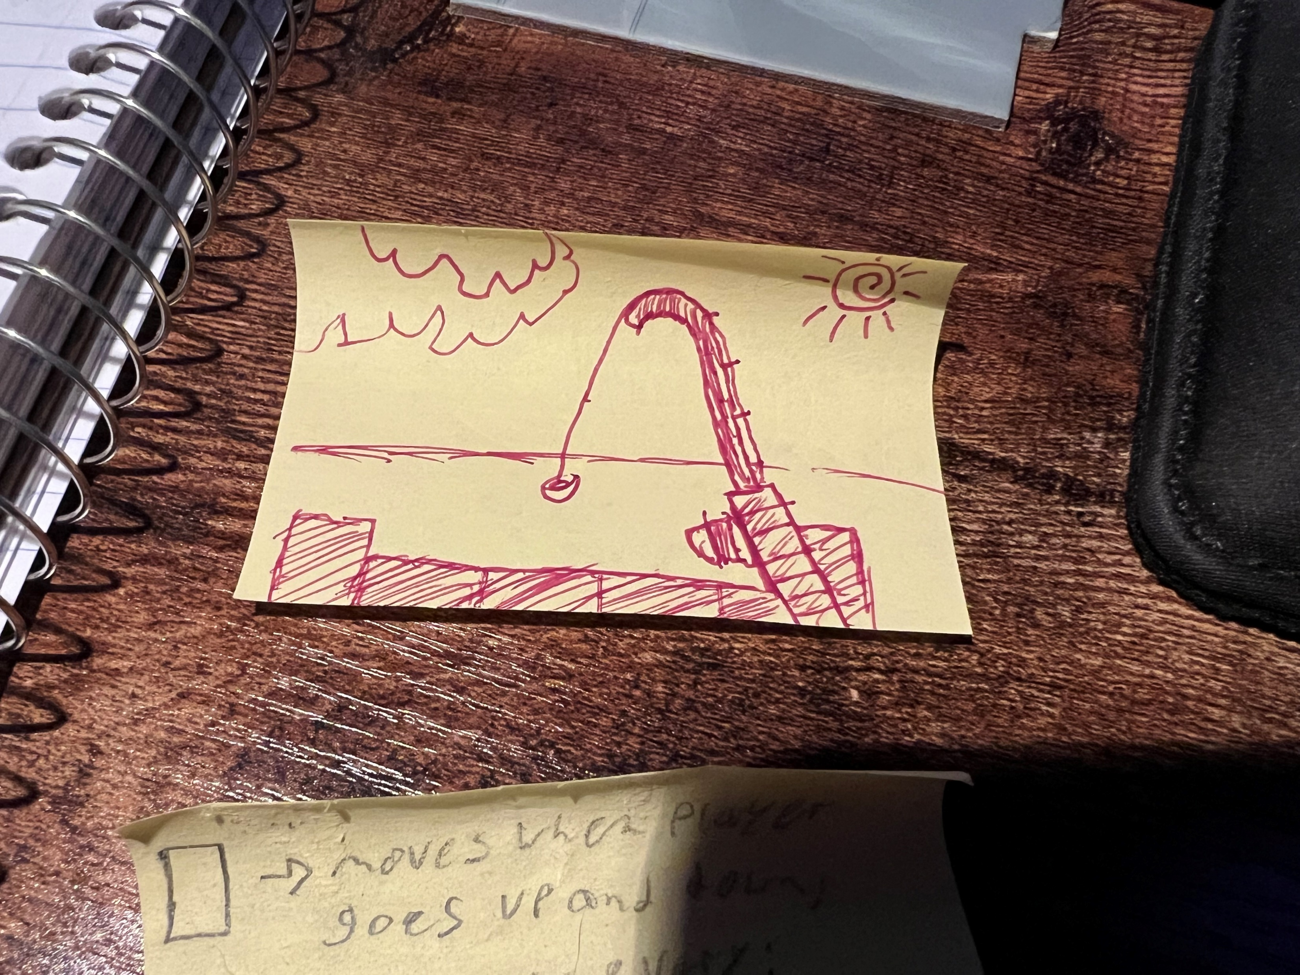
Fishing Minigame
Concept created from experience with other games
Lots of random numbers being generated
Takes the item data from scriptable objects to reach a result.

Slide 12
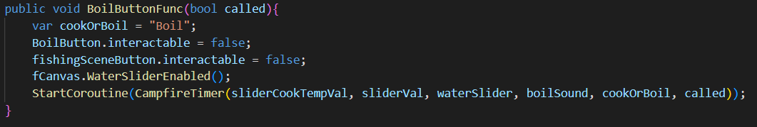
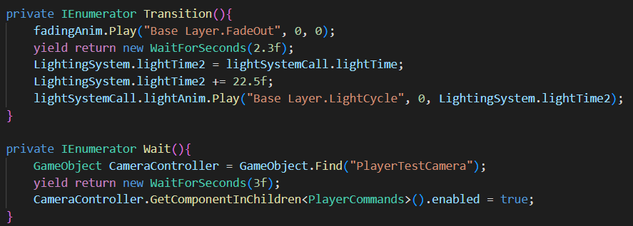
Coroutines

Slide 13
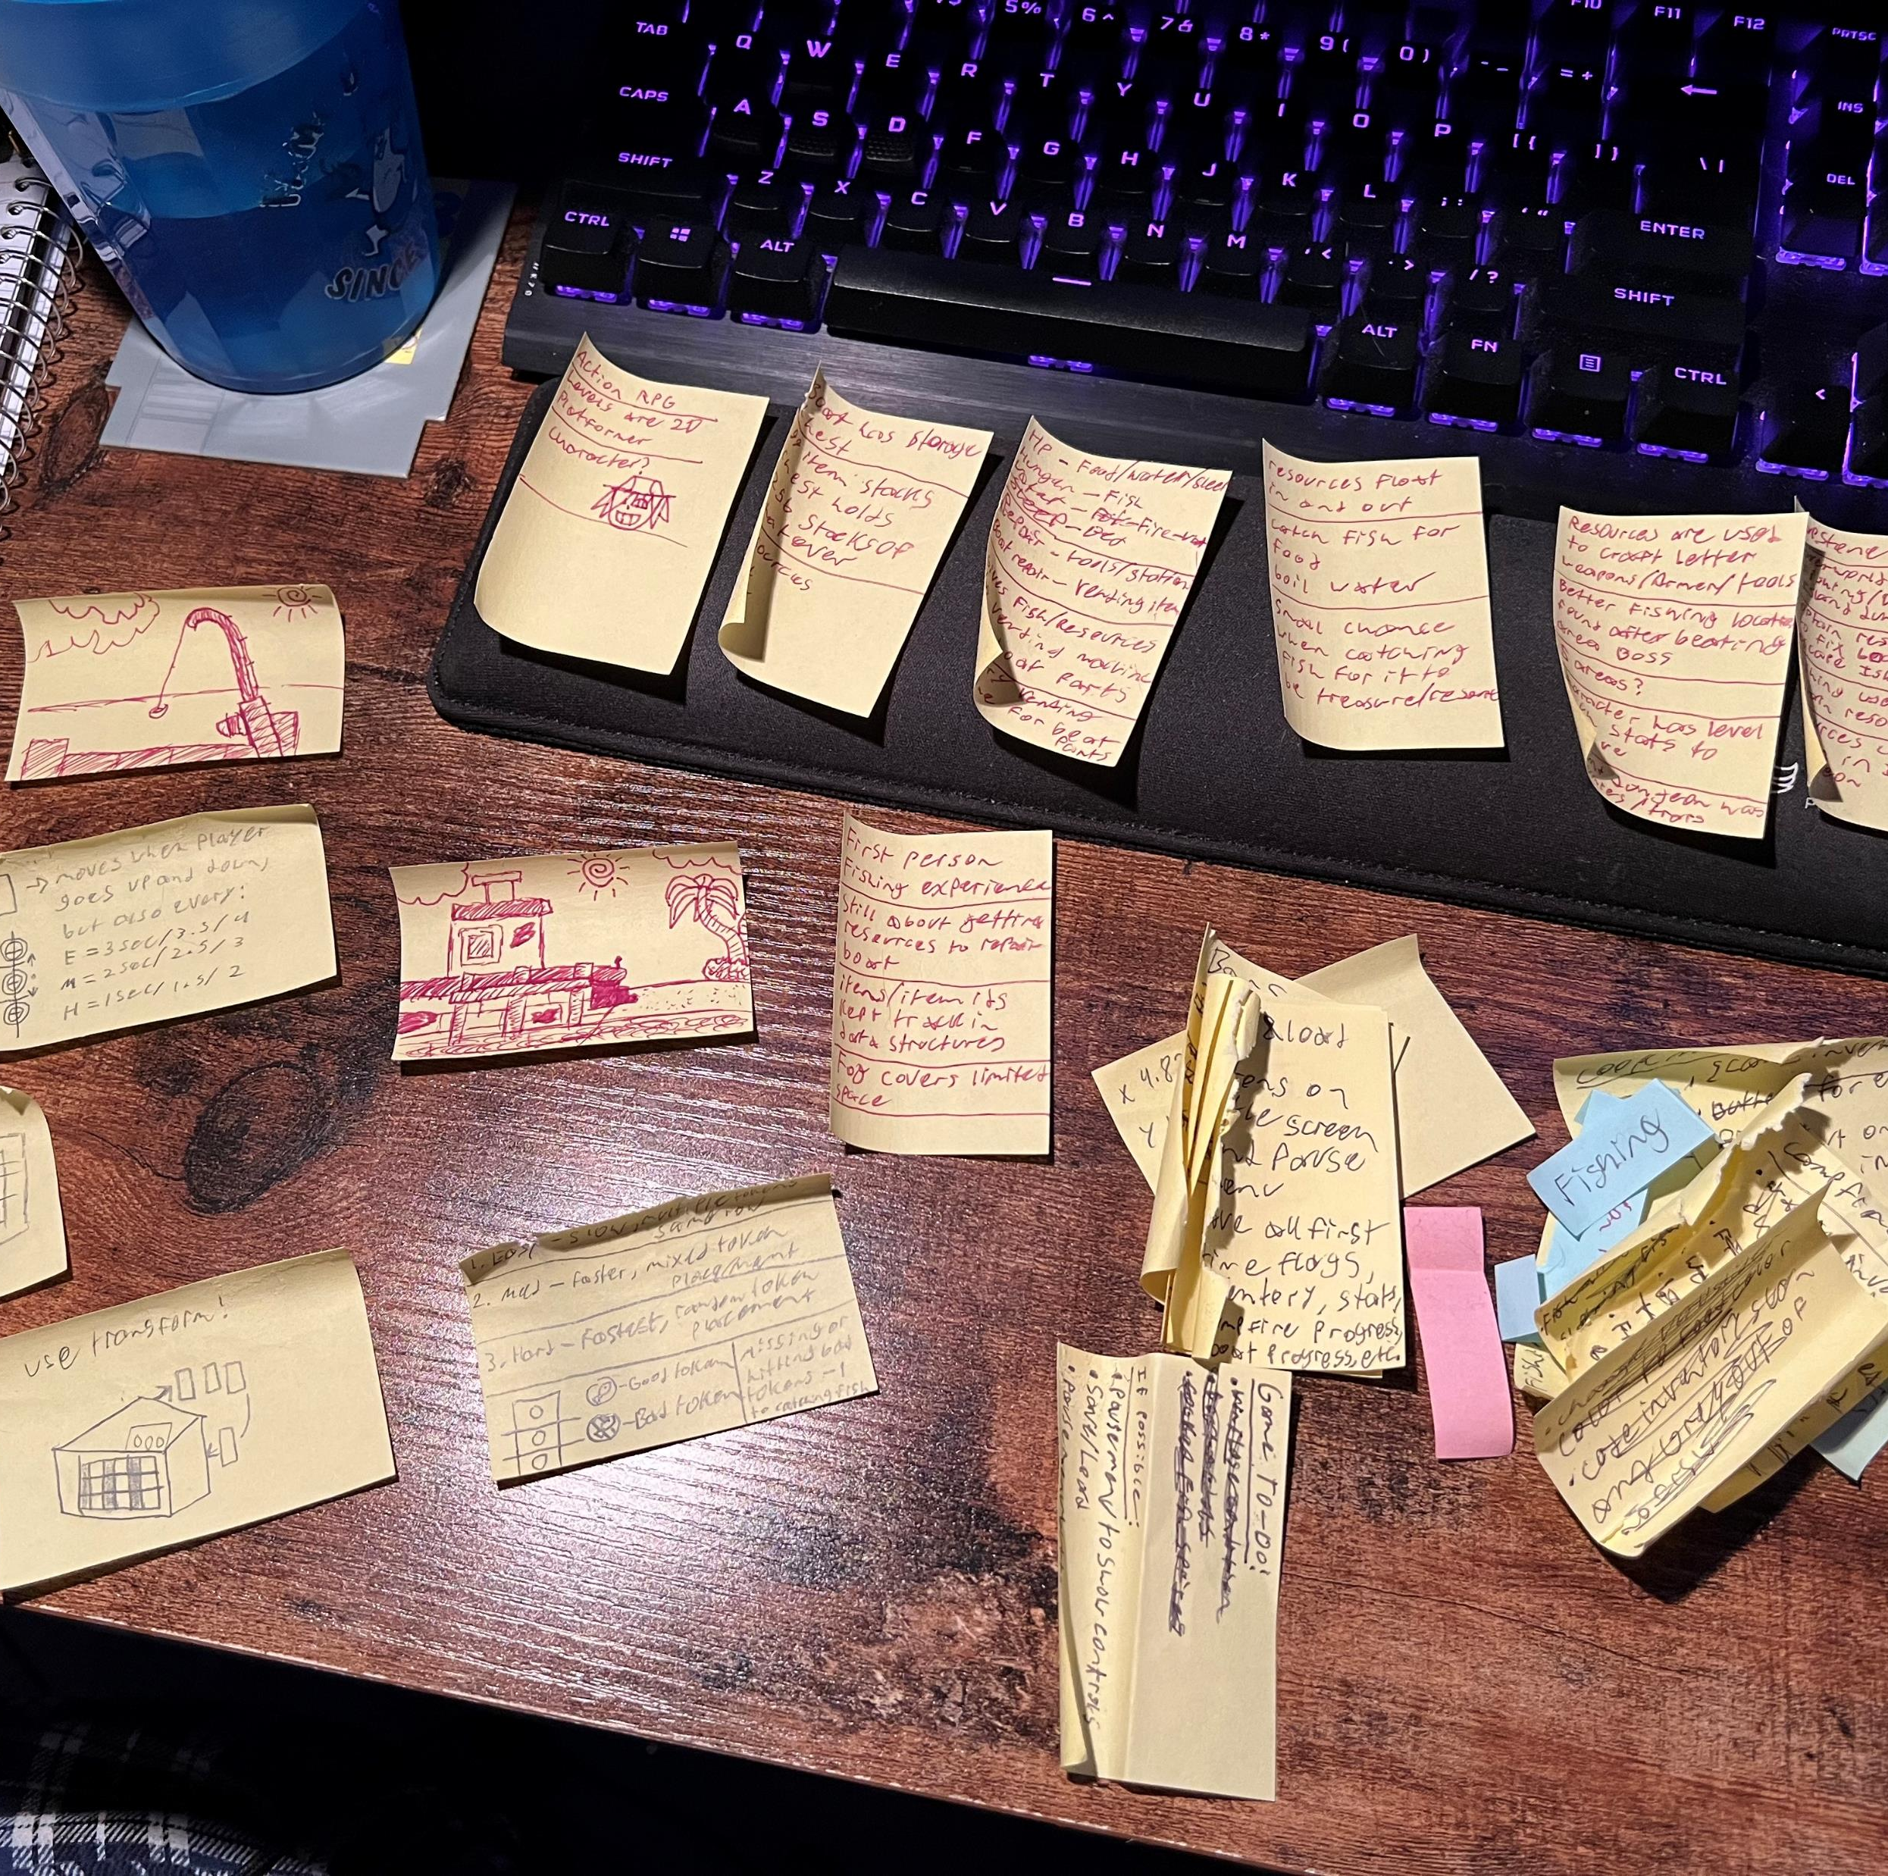
Key Lessons & Future Ideas
Keep track of feasible ideas
Do not get stuck on perfecting
Watch out for feature bloat
Do not be afraid to get free online assets
Ideas:
Better fishing UI and Animations.
Win animation of boat leaving
Ways to increase chances of getting certain fish or materials
Save and load functionality

Slide 14

Questions?

Slide 15
Resources:
Sound files: https://pixabay.com/sound-effects/
Inventory Tutorial 0 – 7:
https://youtube.com/playlist?list=PL-hj540P5Q1hLK7NS5fTSNYoNJpPWSL24&si=Sf13qhRdDl8T8_cX
https://www.youtube.com/@DanPos

